Slide 1
Agile Software Development with Scrum
Ray Mitchell III

Slide 2

Recommended Book
Essential Scrum: A Practical Guide to the Most Popular Agile Process
By Kenneth S. Rubin

Slide 3
Introduction
Topics:
What is Scrum?
Scrum Origins
Why Scrum?
Can Scrum Help You?

Slide 4
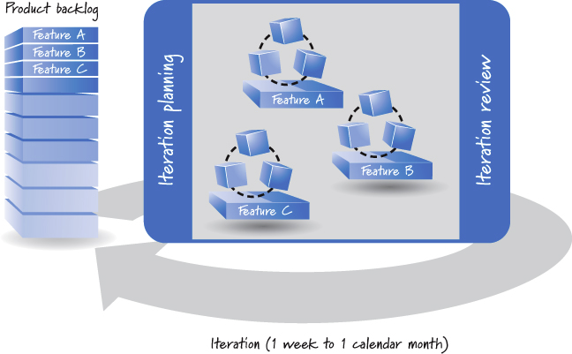
What is Scrum?
Agile approach for developing products & services
Notes:
Agile approach:
Create product backlog – prioritized list of features
Work on most important items first
When run out of time any work that didn’t get done will be lower priority than completed work
Work performed in iterations (1 week to 1 month)
Cross-functional team does all of the work
Designing, building, testing
Backlog typically much larger than work that can be completed in one iteration
Iteration start:
Team plans which high-priority of subset to create in iteration
Iteration end:
Team has potentially shippable product
Team reviews completed features with stakeholder to get feedback
Team incorporates feedback in form of new features in backlog
Iterations repeat

Slide 5
Scrum Origins
1986 article in Harvard Business Review described how several companies produced world-class results using scalable, team-based approach to product development
Scrum is rugby term referring to way of restarting game
Metaphor for going a short distance, taking measure, repeating

Slide 6
Why Scrum?
Well-suited to complex domains
Bleeding-edge, continuously evolving, new products that have never been built before
Supports exploration of potential solutions without big up-front design

Slide 7
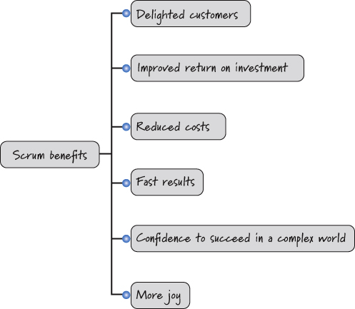
Can Scrum Help You?
Are you happy with the results of your software development efforts?
More often than not, people say “No”
Organizations that have diligently applied scrum see benefits:
Notes:
Scrum delivers:
Working, integrated, tested, business-valuable features each iteration
Customers delighted
Participants enjoy working with scrum

Slide 8
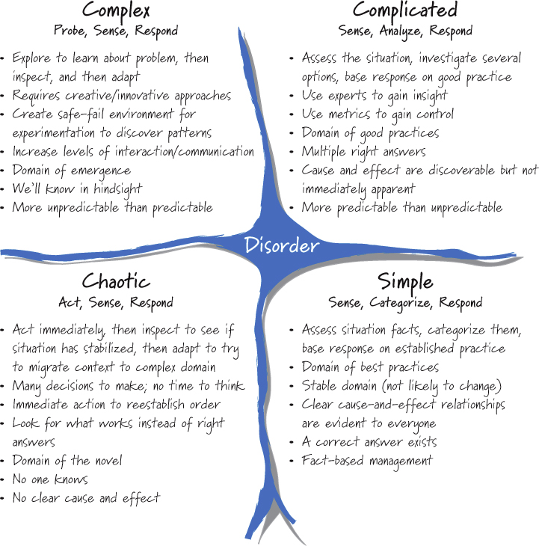
Is Scrum Right For Everyone?
Complex
Scrum is ideal
Complicated
Scrum can work but might not be ideal
Simple
Scrum can be used but may not be most efficient
Chaotic
Scrum not best solution
Disorder
Need to figure out which of other domains you’re in
Notes:
Cynefine sense-making framework:
Helps us understand situation in which we operate
Complex problems:
Things more unpredictable than predictable
If right answer, will only know with hindsight
Domain of emergence
Need to explore and learn about problem, then inspect & adapt
Routine cookie-cutter solutions don’t apply
Complicated problems:
Domain of good practices dominated by experts
Might be multiple right answers; expert diagnosis required to figure them out
E.g. Performance optimization calls for adjusting parameters to find ebest overal system performance
Would be better served assembling experts, letting them assess, investigate options, and select
Much day-to-day software maintenance falls into this category
Six Sigma well-suited
Simple problems:
Everyone can see cause & effect
Right answer obvious and undisputed
Domain of legitimate best practices
Once assess facts can determine proper predefined solution to use
E.g. Product same product over and over; assembly line process would be better fit than scrum
Chaotic problems:
Require rapid response
In crisis and need to act immediately
E.g. algorithm producing erroneous results
Scrum not best solution; not interested in priorizing backlog of work then acting in iterations
Need to act immediately
Disorder:
Worst place you can be
You need to figure out which domain you’re in so you can select proper process to address

Slide 9
Core Concepts

Slide 10
Scrum Framework
Topics:
Overview
Scrum Roles
Scrum Activities & Artifacts

Slide 11
Overview
Scrum is a framework for organizing and managing work
Based on set of values, principles, and practices
Provide foundation to which your organization will add unique implementation
Scrum is like foundation and walls of building
You customize internal structure
Scrum is people-centric based on principals:
Honesty, openness, courage, respect, focus, trust, empowerment, collaboration

Slide 12
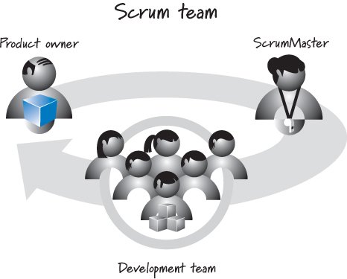
Scrum Roles
Scrum development consists of one or more scrum teams:
Three scrum roles:
Product owner
Responsible for what will be developed and in what order
ScrumMaster
Responsible for guiding team in creating own process using scrum framework
Development team
Responsible for determining how to deliver what product owner has asked for
Notes:
Product owner
Empower central point of product leadership
Single authority responsible for deciding which features & functionality to build
Communicates to all other participants clear vision of what scrum team trying to achieve
ScrumMaster
Helps everyone involved understand and embrace scrum values
Acts as coach helping organization develop own scrum approach
Helps the org through moving over to scrum process when it’s new
Helps team resolve issues
Helps protect team from outside interference
Has no authority to exert control over the team
Not the same as traditional role of project / dev manager
Dev team
Diverse cross-functional collection of various dev types
Traditionally referred to as architects, programmers, testers, DBA’s, etc.
Typically 5 to 9 people; if more people on project they’re typically broken into multiple scrum teams

Slide 13
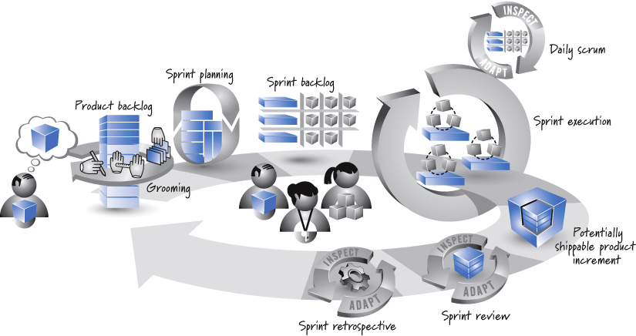
Scrum Activities & Artifacts
The scrum process:
Notes:
Product owner has vision of what he wants to create
Activity called “grooming” performed to break vision into prioritized list of features call product backlog
Sprint starts with spring planning in which subset of product backlog selected to be implemented during sprint (this subset called the sprint backlog)
Items in the sprint backlog broken into tasks which are estimated
Breaking items into sprint backlog gives team confidence they’ve selected an amount of work that can reasonably be completed in the sprint
Sprint execution does the work to complete the sprint backlog
Sprint ends with review & retrospective
Scrum cycle repeats with next sprint
After appropriate number of sprints, product owner’s vision will be realized and product can be released

Slide 14
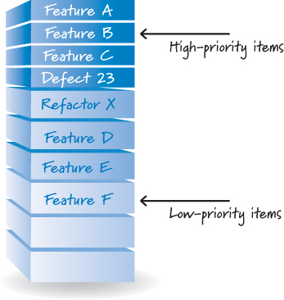
Product Backlog
Most valuable work always done first
Product owner keeps product backlog in prioritized order
Collaborates with stakeholders
Collaborates with development team
Notes:
Product owner has vision of what he wants to create
Activity called “grooming” performed to break vision into prioritized list of features call product backlog
Sprint starts with spring planning in which subset of product backlog selected to be implemented during sprint (this subset called the sprint backlog)
Items in the sprint backlog broken into tasks which are estimated
Breaking items into sprint backlog gives team confidence they’ve selected an amount of work that can reasonably be completed in the sprint
Sprint execution does the work to complete the sprint backlog
Sprint ends with review & retrospective
Scrum cycle repeats with next sprint
After appropriate number of sprints, product owner’s vision will be realized and product can be released

Slide 15
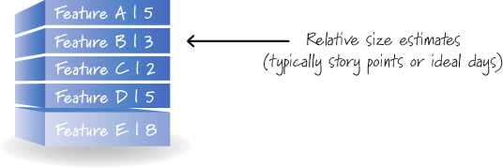
Product Backlog (cont’d)
Development team estimates work required for items in product backlog
Relative sizes used to estimate work
Units used are story points or ideal days (more on this later)
E.g. feature C is size 2 and feature E is size 8 so we can conclude that feature E is 4 times larger than feature C

Slide 16
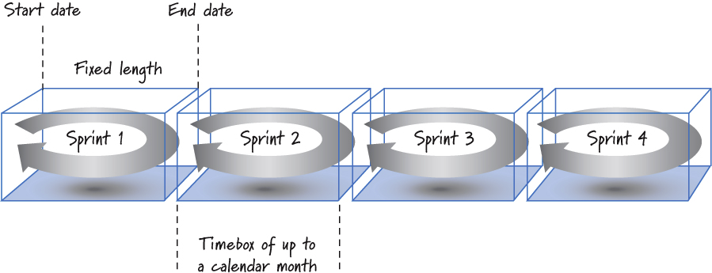
Sprints
Work performed in iterations (cycles) up to a calendar month called sprints
Sprints timeboxed
Always have fixed start & end date
Notes:
Sprints should always have the same duration
Do not permit any goal-altering changes in scope or personnel during a sprint

Slide 17
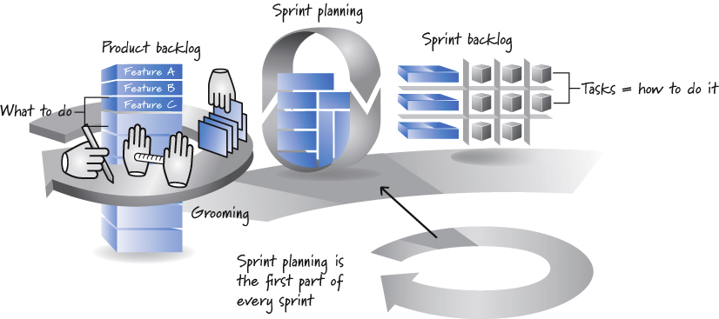
Sprint Planning
Sprint planning at beginning of sprint determines most important subset of items from product backlog that will be in next sprint
Notes:
Sprints should always have the same duration
Do not permit any goal-altering changes in scope or personnel during a sprint
Sustainable pace - Team selects items from product backlog that can be completed at a sustainable pace
Sprint backlog – Team breaks down items from product backlog into tasks (estimated using hours)
Just-in-time planning
Sprint planning typically 4-to-8 hours for two-week sprints

Slide 18
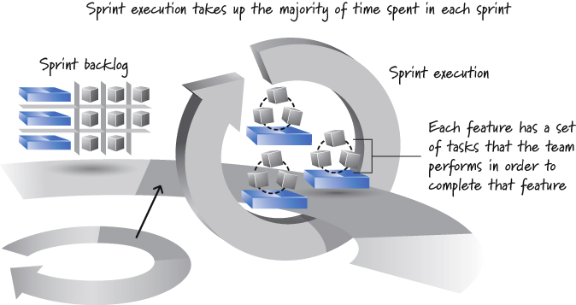
Sprint Execution
Development team performs all task-level work
Notes:
ScrumMaster coaches
Product owner
Answers questions regarding items in sprint as needed
Reviews work as it’s being completed

Slide 19
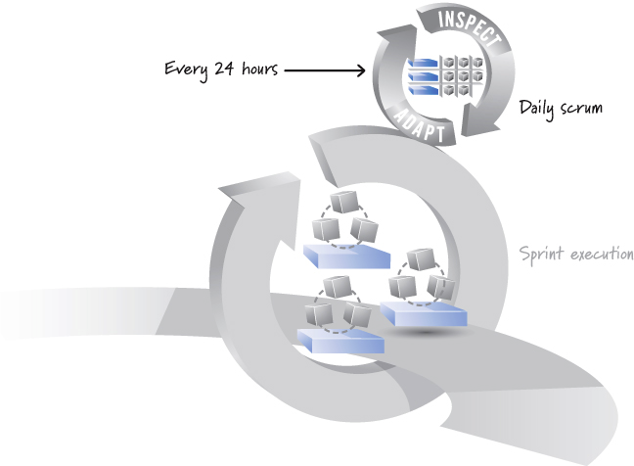
Daily Scrum
Daily timeboxed (15 minutes or less) meeting
Notes:
AKA daily stand-up
ScrumMaster typically facilitates
Each member answers three questions:
What did I accomplish since the last daily scrum?
What do I plan to work on by the next daily scrum?
What are the obstacles or impediments that are preventing me from making progress?
Keeps everyone in the loop on big picture
ScrumMaster will help eliminate impediments that team can’t resolve on own

Slide 20
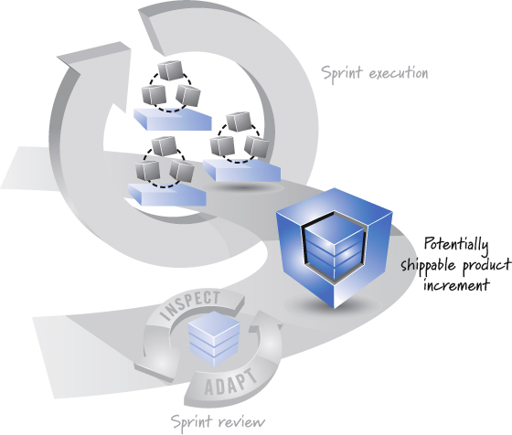
Done
Sprint result is a potentially shippable product increment
Notes:
This means, whatever the scrum team agreed to do is really done according to its agreed-upon definition of done
Definition of done specifies degree of confidence that the work completed is of good quality and potentially shippable
Bare minimum definition of done is:
Designed, built, integrated, tested, documented

Slide 21
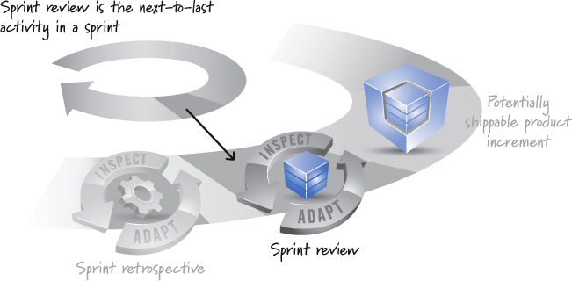
Sprint Review
Meeting at end of sprint to review completed work
Notes:
Demo of just-completed features is given
Goal is to inspect and adapt the product being built
Conversation takes place among scrum team, stakeholders, sponsers, customers

Slide 22
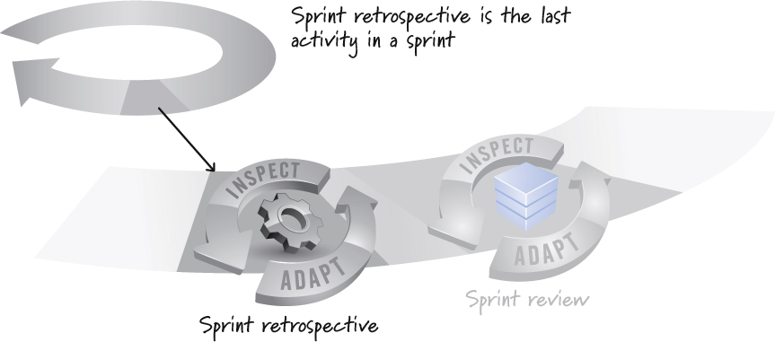
Sprint Retrospective
Meeting at end of sprint to review the process
Notes:
Time to inspect and adapt the process
Dev team, ScrumMaster, product owner discuss what is and is not working with Scrum and associated tech processes
Focus is on continous process improvement

Slide 23
Agile Principles
Topics:
Scrum Compared to Plan-Driven
Scrum Principles
Variability & Uncertainty
Prediction & Adaptation
Validated Learning
Work in Process (WIP)
Progress
Performance

Slide 24
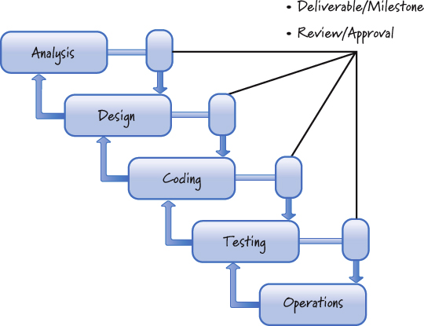
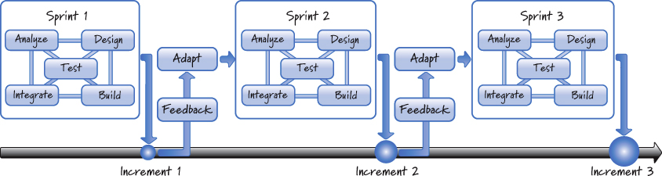
Scrum Compared to Plan-Driven
Plan-driven
Breaks development into phases
Attempts to anticipate up front all features user needs
Scrum
Repeatedly delivers new completed functionality in iterations
Incorporates changing user needs
Notes:
Waterfall works well if you are applying it to problems that are well-defined, predictable, and unlikely to undergo any significant change
Problem is most dev efforts unpredictable
Gives impression of orderly, accountable, and measurable approach
False sense of security
For many, a plan-driven, sequential process looks like it should work
If it doesn’t prevailing attitude is that we must have done something wrong
Problem is not the execution
Problem is that plan-driven approaches are based on set of beliefs that do not match the uncertainty inherit in most product development efforts

Slide 25
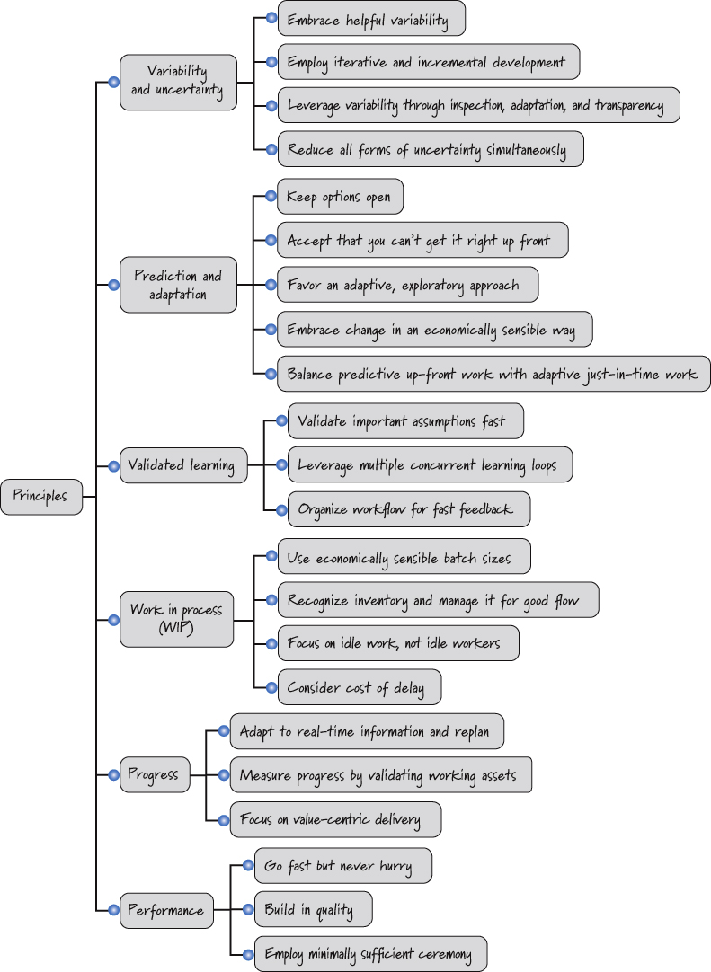
Scrum Principles
Scrum based on different set of beliefs than waterfall
These principles map well to problems with enough uncertainty to make high levels of predictability difficult
Notes:
Waterfall works well if you are applying it to problems that are well-defined, predictable, and unlikely to undergo any significant change
Problem is most dev efforts unpredictable

Slide 26
Variability & Uncertainty
Four principles
Embrace helpful variability
Employ iterative and incremental development
Leverage variability through inspection, adaptation, and transparency
Reduce all forms of uncertainty simultaneously

Slide 27
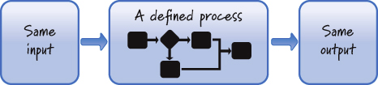
Principle: Embrace helpful variability
Plan-driven
Treats product development like manufacturing
Shuns variability, encourage conformance to defined process
Scrum
Realizes that in product development the goal is to create a unique single instance of the product, not to manufacture the product
Adapts to variability with each sprint-level interval
Notes:
product development is not at all like product manufacturing
In manufacturing our goal is to take a fixed set of requirements and follow a sequential set of well-understood steps to manufacture a finished product that is the same (within a defined variance range) every time
In product development, however, the goal is to create the unique single instance of the product, not to manufacture the product.
we want to create a unique recipe for a new product. Some amount of variability is necessary to produce a different product each time.
every feature we build within a product is different from every other feature within that product, so we need variability even at this level

Slide 28
Principle: Employ iterative and incremental development
Plan-driven
Uses big-bang development
Assumes that we will get things right up front and that most or all of the product pieces will come together late in the effort.
Scrum
Uses iterative development
Acknowledges we will probably get things wrong before we get them right
Iterative development is a planned rework strategy
Uses incremental development
“Build some of it before you build all of it.”
Notes:
Iterative
For example, we might start by creating a prototype to acquire important knowledge about a poorly known piece of the product.
Then we might create a revised version that is somewhat better, which might in turn be followed by a pretty good version.
Iterative development is an excellent way to improve the product as it is being developed.
Downside: Don’t know how many passes will be required
Incremental
Avoid having one large, big-bang-style event
By building one small piece at a time we can adapt as product takes shape

Slide 29
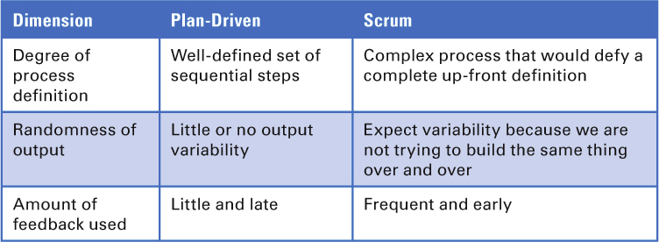
Principle: Leverage variability through inspection, adaptation, and transparency
Plan-driven
Does not adapt to variability
Change is difficult
Scrum
Supports inspection, adaptation, transparency

Slide 30
Principle: Reduce all forms of uncertainty simultaneously
Two categories of uncertainty:
End uncertainty (what uncertainty)
Uncertainty surrounding the features of the final product
Means uncertainty (how uncertainty)
Uncertainty surround the process and technologies used to develop a product
Plan-driven
Focus first on eliminate all end uncertainty by fully defining up front what is to be built
Simplistic approach to uncertainty is ill-suited to complex product development where our actions and the environment mutually constrain one another
Scrum
We don’t constrain ourselves by fully addressing one type of uncertainty first
Instead we focus simultaneously on all uncertainties
Notes:
e.g. in scrum
We decide to build a feature (our action)
We show the feature to a customer, who, once he sees it, changes his mind
We make design changes based on the feedback

Slide 31
Prediction & Adaptation
When using scrum, we are constantly balancing the desire for prediction with the need for adapation
Five principles
Keep options open
Accept that you can’t get it right up front
Favor an adaptive, exploratory approach
Embrace change in an economically sensible way
Balance predictive up-front work with adaptive just-in-time work

Slide 32
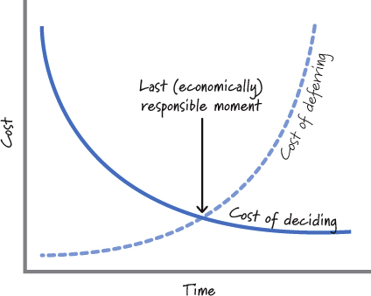
Principle: Keep options open
Plan-driven
Requires important decisions in areas like requirements or design be made, reviewed, and approved within their respective phases
Decisions must be made before transitioning to next phase, even if based on limited knowledge
Scrum
Delay decisions until last responsible moment

Slide 33
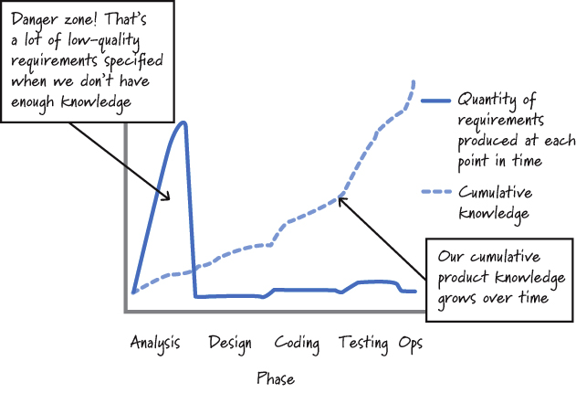
Principle: Accept that you can’t get it right up front
Plan-driven
Assume that we can “get it right” up front
Phased approach assumes work completed in each phase is complete and accurate
Scrum
Acknowledge that we can’t get all of the requirements or plans right up front
Iterative approach allows for adaptation as more knowledge is gained

Slide 34
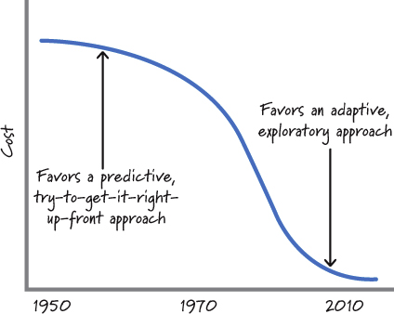
Principle: Favor an adaptive, exploratory approach
Exploration
Definition
Gaining knowledge by doing some activity, such as building a prototype
Cost
Historically was high but has become much cheaper
Plan-driven
Focuses on using what is currently known and predicting what isn’t known
Scrum
Favors a more adaptive, trial-and-error approach based on appropriate use of exploration
Notes:
Exploration refers to times when we choose to gain knowledge by doing some activity, such as building a prototype, creating a proof of concept, performing a study, or conducting an experiment. In other words, when faced with uncertainty, we buy information by exploring.
Example, early in software development running programs using punch cards on a mainframe was very expensive so up-front design and planning were worth it. Now prototyping is much more cost-effective.

Slide 35
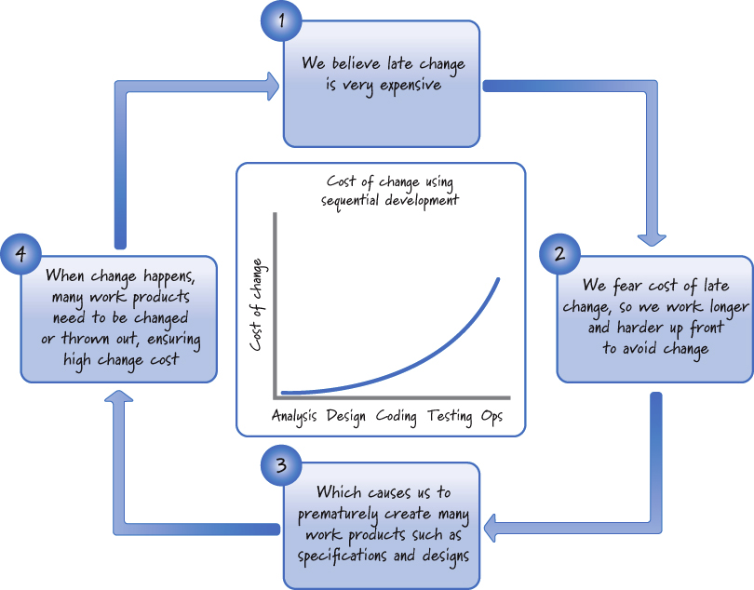
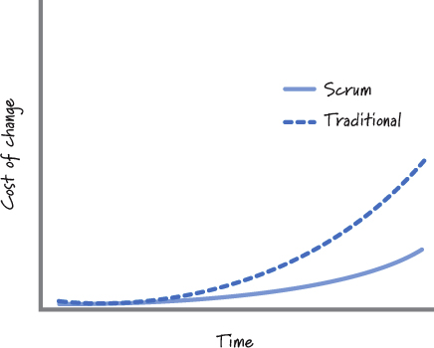
Principle: Embrace Change in an Economically Sensible Way
Plan-driven
Change is more expensive late than it is early on
Scrum
Assumes that change is the norm and we can’t predict away uncertainty
Notes:
e.g. With waterfall a change made during analysis might cost $1; that same change made late during testing might cost $1,000. Reason, key design decisions might have been made on assumptions due to the analysis that is changed.
To avoid late changes, sequential processes seek to carefully control and minimize any changing requirements or designs by improving the accuracy of the predictions about what the system needs to do or how it is supposed to do it.
Unfortunately, being excessively predictive in early-activity phases often has the opposite effect. It not only fails to eliminate change; it actually contributes to deliveries that are late and over budget as well.
Cost of change lower in scrum because we limit the amount of work in process at any given time; when change is detected only that work or the work completed to that point may be impacted

Slide 36
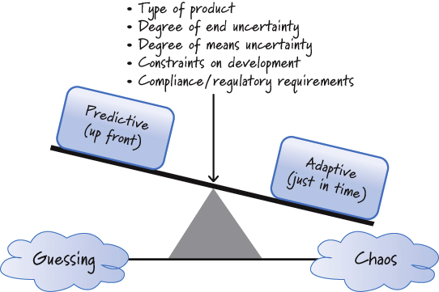
Principle: Balance predictive up-front work with adaptive just-in-time work
Plan-driven
Detailed up-front requirements and planning are critical
Should be completed before moving to later stages
Scrum
Acknowledge that it’s not possible to get requirements and plans precisely right up front
Balance between predictive up-front work and adaptive just-in-time work

Slide 37
Validated Learning
When using scrum, we organize the work to quickly create validated learning
Three principles
Validate important assumptions fast
Leverage multiple concurrent learning loops
Organize workflow for fast feedback

Slide 38
Principle: Validate important assumptions fast
Assumption
Definition
A guess or belief that is assumed to be true, real, or certain even though we have no validated learning to know that it is true
A significant development risk
Plan-driven
Produce extensive up-front requirements and plans that likely embed many important assumptions
Tolerates long-lived assumptions because they won’t be validated until a much later phase of development
Scrum
We try to minimize number of important assumptions that exist at any time
Iterative & incremental development along with focus on low-cost exploration used to validate assumptions fast

Slide 39
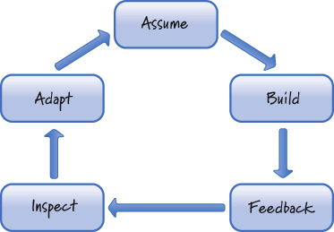
Principle: Leverage multiple concurrent learning loops
Learning
An important form of learning occurs only after features have been built, integrated, and tested
Late learning provides reduced benefits because may be insufficient time to leverage the learning or the cost may be too high
Plan-driven
Delays integration and testing to the end phases
Scrum
Constant learning is a key to success
Iterative development and definition of done ensure integration and testing are done for completed features

Slide 40
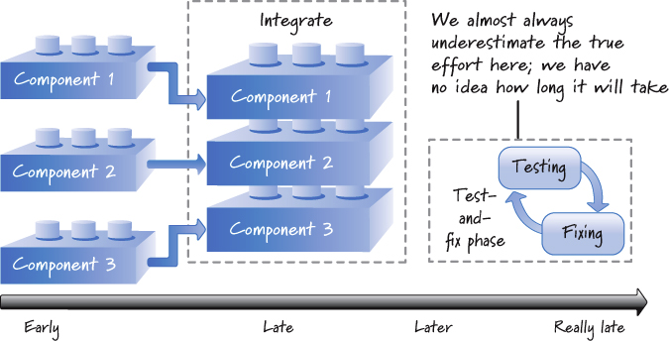
Principle: Organize workflow for fast feedback
Plan-driven
Being tolerant of long-lived assumptions makes plan-driven processes tolerant of late learning
Fast feedback is not a focus
Sequential completion of phases assumes that earlier activities can be completed without feedback generated by later activities
Scrum
Fast feedback is a focus
Fast feedback helps truncate wrong paths sooner
Fast feedback vital for uncovering and exploiting time-sensitive, emergent opportunities
Notes:
Plan-driven example: Integrating 3 components late in the process
Scrum example: Integrating of 3 components makes assumptions so we would do it ASAP (as soon as functionality for each component started being completed)

Slide 41
Work in Process (WIP)
Work in Process (WIP) refers to the work that has been started but not yet finished
During product development WIP must be recognized and properly managed
Three principles
Use economically sensible batch sizes
Recognize inventory and manage it for good flow
Focus on idle work, not idle workers

Slide 42
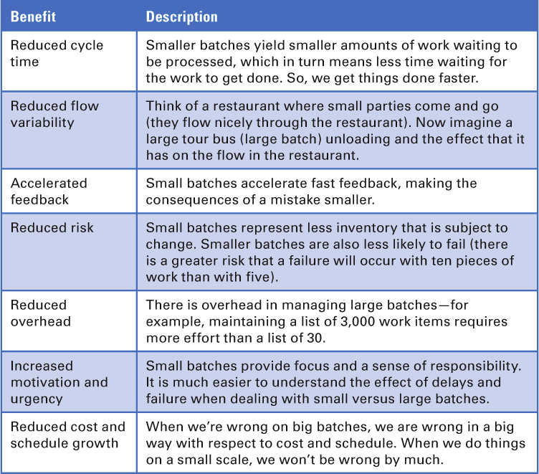
Principle: Use economically sensible batch sizes
Plan-driven
Preferable to batch up all of one type of work (e.g. requirements analysis) and perform it in a single phase
Batch size is 100%
Approach based, in part, on believing old manufacturing principle of economies of scale applies to product development
Principle states cost of producing a unit will go down as we increase the number of units
Scrum
Accept that applying economies-of-scale thinking dogmatically to product development will cause significant harm
Working in smaller batches has many benefits

Slide 43
Principle: Recognize inventory and manage it for good flow
Inventory
In product development inventory is Work in Process (WIP)
The greater the amount of WIP the greater the cost of change
Plan-driven
Encourages batch sizes of 100% meaning the entire project is WIP
Any change that affects any part of the project is guaranteed to require rework
Scrum
Encourages delaying WIP until it is needed (just-in-time) minimizing the cost of change
Notes:
Example: A large number of requirements have been written and a fundamental change comes through that affects all those requirements.

Slide 44
Principle: Focus on idle work, not idle workers
Idle work
Work that we want to do (such as building or testing) but can’t do because something it preventing us
Idle workers
People who have available capacity but not currently 100% utilized
Scrum
Encourages ensuring that blockers related to work be removed with less emphasis on idle workers

Slide 45
Progress
When using scrum, we measure progress by what we have delivered and validated, not by how we are proceeding according to the predefined plan or how far we are into a particular phase or stage of development.
Three principles
Adapt to real-time information and replan.
Measure progress by validating working assets.
Focus on value-centric delivery.

Slide 46
Principle: Adapt to real-time information and replan
Plan-driven
The plan is the authoritative source on how and when work should occur.
Conformance to the plan is expected.
Scrum
Believe that unbridled faith in the plan will blind us to the fact that the plan might be wrong.
Goal is not to conform to some plan (some up-front prediction).
Goal is to rapidly replan and adapt to the stream of economically important information that is continuously arriving during development.

Slide 47
Principle: Measure progress by validating working assets
Plan-driven
Progress demonstrated by completing a phase and being permitted to enter the next phase.
If a phase starts and completes as expected, product development effort might seem to be progressing well.
In the end, product we created might deliver far less customer value than expected.
Scrum
Progress measured by building working, validated assets that deliver value and that can be used to validate important assumptions.
Progress gives us feedback to know what next right step is.
It’s not about how much work we start; it’s all about what customer-valuable work we finish.

Slide 48
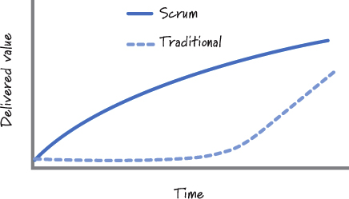
Principle: Focus on value-centric delivery
Plan-driven
Focuses on diligently following the process.
Integration and delivery of features happen at the end of the effort.
Risk we will run out of resources before we deliver all of the important value to our customers.
Belief that planning and document artifacts are valuable but they rarely are of use to the customer.
Scrum
Highest-value features are continuously built and delivered in next iteration.
Customers get continuous flow of high-value features.
Believe that intermediate artifacts provide no perceived customer value.

Slide 49
Performance
There are specific performance-related characteristics we expect when using scrum
Three principles
Go fast but never hurry
Build in quality
Employ minimally sufficient ceremony

Slide 50
Principle: Go fast but never hurry
Plan-driven
Belief that if we follow the plan and do things right the first time, we’ll avoid costly and time-consuming rework.
Scrum
Goal is to be nimble, adaptable, and speedy.
We get fast feedback and value into the hands of the customers sooner.
Time is of the essence but we don’t rush to get things done. Doing so would violate the principle of sustainable pace.

Slide 51
Principle: Build in quality
Plan-driven
Belief that through careful, sequential performance of work we get a high quality product
Can’t verify this quality until we do testing of integrated product, which occurs during a late phase.
If testing indicates quality is lacking, we must enter costly test-and-fix phase.
Testing team often viewed as separate from the development team.
Scrum
Quality isn’t something a testing team “tests in” at the end.
Quality is something a cross-functional scrum team owns and continuously builds in and verifies every sprint.
Each increment of value is completed to a high level of confidence.
Need for significant late testing is substantially reduced.

Slide 52
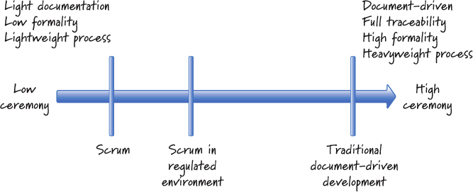
Principle: Employ minimally sufficient ceremony
Plan-driven
Tends to be high-ceremony, document-centric, and process-heavy
Examples of ceremonies that might not be necessary:
Three-day process required for approving and migrating code from the dev to QA environment
All anomalies have to blogged into a software tool when you could just tap the shoulder of the person next to you to ask them to fix an issue
I write a document because now is the prescribed time to write that document, even though nobody can say why that document is necessary or valuable.
Scrum
Little emphasis is put on process-centric ceremonies
Goal is to eliminate unnecessary formality
Ceremonial bar is set at the level that is minimally sufficient
Note, some regulated products require documents and other ceremony; these would of course be done

Slide 53
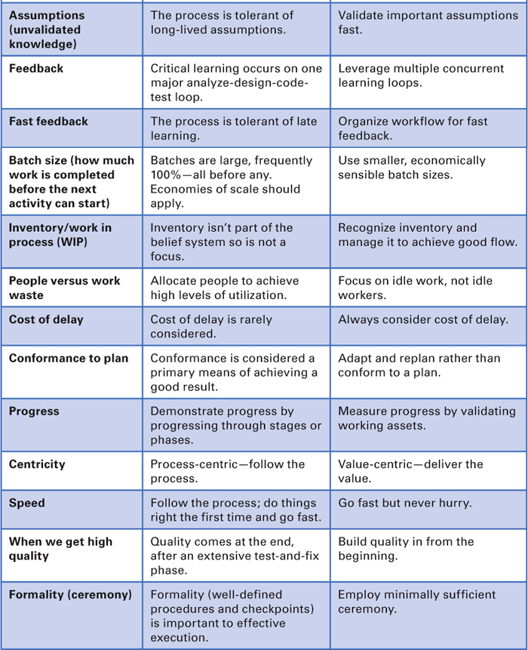
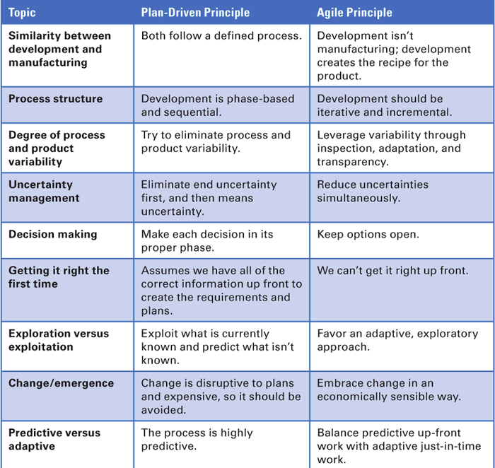
Closing
Summary of plan-driven vs. Agile (Scrum) principles:

Slide 54
Sprints
Topics:
Overview
Timeboxed
Short Duration
Consistent Duration
No Goal-Altering Changes
Definition of Done

Slide 55
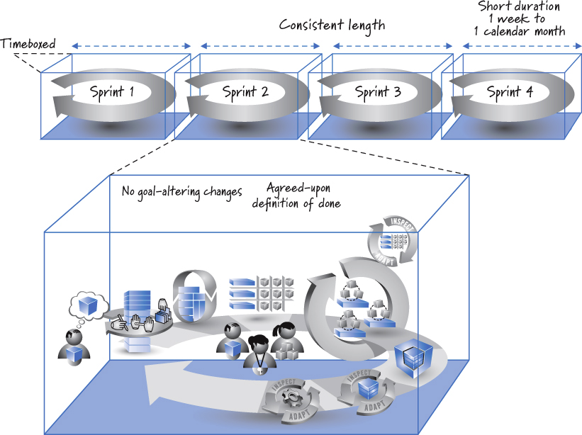
Overview
Sprints are the skeleton of the scrum framework
Notes:
Large gray looping arrow is the spring
Sprints are timeboxed (fixed start & end dates)
Sprints should be consistent in length
No goal-altering changes permitted in a sprint
By end of each sprint a potentially shippable product increment is completed in conformance with team’s definition of done

Slide 56
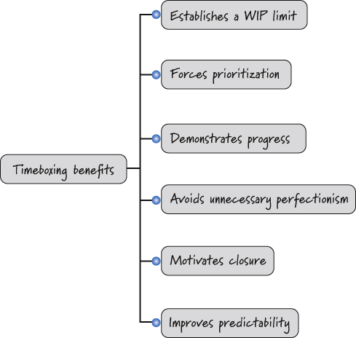
Timeboxed
Sprints are timeboxed
Notes:
Timeboxing is a technique for limiting the amount of WIP (work in process).
Timeboxing forces us to prioritize and perform the small amount of work that matters most.
Timeboxing also helps us demonstrate relevant progress by completing and validating important pieces of work by a known date (the end of the sprint)
Timeboxing helps avoid unnecessary perfectionism.
Timeboxing also motivates closure. My experience is that things are more likely to get done when teams have a kn
Timeboxing improves predictability. Although we can’t predict with great certainty exactly the work we will complete a year from now, it is completely reasonable to expect that we can predict the work we can complete in the next short sprint.own end date.

Slide 57
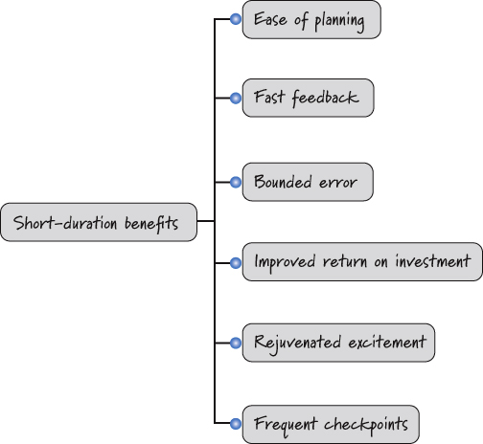
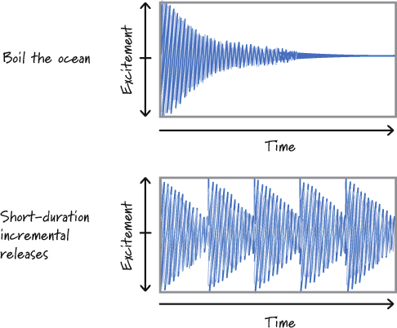
Short Duration
Sprints are short duration (1 week to 1 month)
Rejuvenated excitement:
Notes:
Short-duration sprints make it easier to plan. It is easier to plan a few weeks’ worth of work than six months’ worth of work.
Short-duration sprints generate fast feedback. During each sprint we create working software and then have the opportunity to inspect and adapt what we built and how we built it.
Short-duration sprints not only improve the economics via fast feedback; they also allow for early and more frequent deliverables.
Short-duration sprints also bound error. How wrong can we be in a two-week sprint?
Short-duration sprints can help rejuvenate excitement. It is human nature for interest and excitement to decline the longer we have to wait for gratification
Short-duration sprints also provide multiple, meaningful checkpoints

Slide 58
Consistent Duration
As a rule, on a given development effort, a team should pick a consistent duration for its sprints and not change it unless there is a compelling reason.
Benefits
Cadence
Provide predictable rhythm allowing team to “get into the zone”
Levels out the intensity of the work
Simplifies planning
Scheduling recurring meetings is simple
Notes:
Compelling reasons to change duration:
You are considering moving from four-week sprints to two-week sprints in order to obtain more frequent feedback but want to try a couple of two-week sprints before making a final decision.
The annual holidays or end of the fiscal year make it more practical to run a three-week sprint than the usual two-week sprint.
The product release occurs in one week, so a two-week sprint would be wasteful.
Not reasons:
The fact that the team cannot get all the work done within the current sprint length is not a compelling reason to extend the sprint length.
Neither is it permissible to get to the last day of the sprint, realize you are not going to be done, and lobby for an extra day or week.

Slide 59
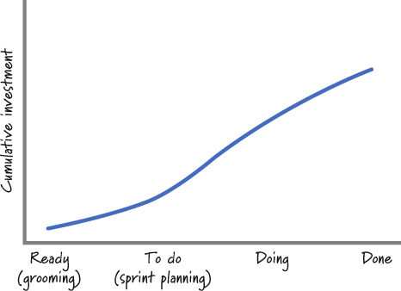
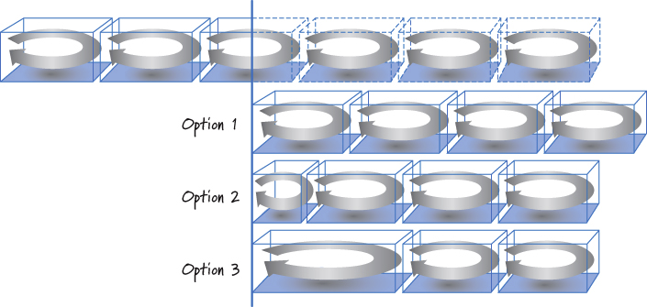
No Goal-Altering Changes
Once the sprint goal has been established and sprint execution has begun, no change is permitted that can materially affect the sprint goal.
Sprint goal
Describes business purpose and value of the sprint
The sprint goal is the foundation of a mutual commitment made by the team and the product owner
Change vs clarification
Although the sprint goal should not be materially changed, it is permissible to clarify the goal.
Consequences of change
Being pragmatic
Critical issues may require sprint to be terminated
Notes:
Sample sprint goals:
• Support initial report generation.
• Load and curate North America map data.
• Demonstrate the ability to send a text message through an integrated software, firmware, and hardware stack.
Clarification means to clarify question about the items in the sprint without substantially changing them

Slide 60
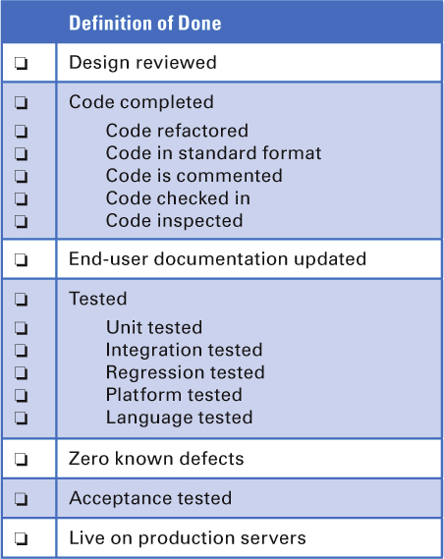
Definition of Done
What is the definition of done?
Checklist of the types of work that the team is expected to successfully complete before it can declare its work to be potentially shippable.
Done and acceptance criteria (see user stories later) must both be met to consider an item complete at the end of a srint.
Example definition of done:

Slide 61
Requirements & User Stories
Topics:
Overview
Using Conversations
Progressive Refinement
What Are User Stories?
Level of Detail
INVEST in Good Stories
Nonfunctional Requirements
Knowledge Acquisition Stories
Gathering Stories

Slide 62
Overview
Plan-driven
Requirements are nonnegotiable specifications to which the product must conform.
Requirements are created up front and given to the development group in the form of a highly detailed document.
Scrum
The details of requirements are negotiated through conversations that happen continuously during development and are fleshed out just in time and just enough for the teams to start building functionality to support that requirement.

Slide 63
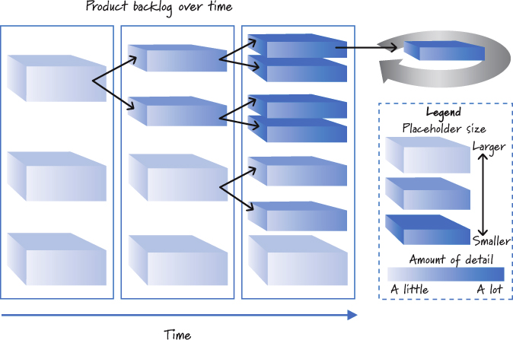
Requirements in Scrum
Product backlog items are of varying levels of detail

Slide 64
Using Conversations
Requirements facilitate a shared understanding of what needs to be built.
They allow the people who understand what should be created to clearly communicate their desires to the people who have to create it.
In Scrum, we leverage conversation as a key tool for ensuring that requirements are properly discussed and commu
The product backlog is a “living document,” available at all times during product development.nicated.

Slide 65
Progressive Refinement
When using Scrum, not all requirements have to be at the same level of detail at the same time.
Requirements that we’ll work on sooner will be smaller and more detailed than ones that we won’t work on for some time.
We employ a strategy of progressive refinement to disaggregate, in a just-in-time fashion, large, lightly detailed requirements into a set of smaller, more detailed items.

Slide 66
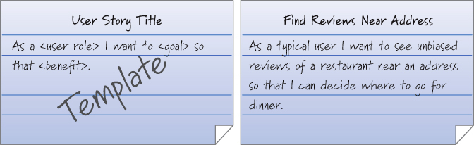

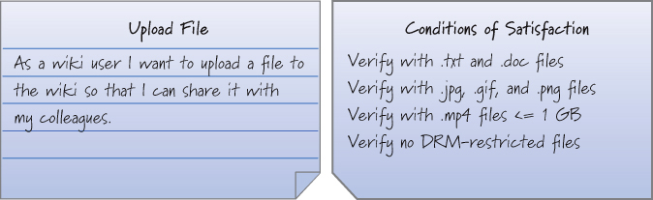
What Are User Stories?
User stories are a convenient format for expressing the desired business value for many types of backlog items, especially features.

Slide 67
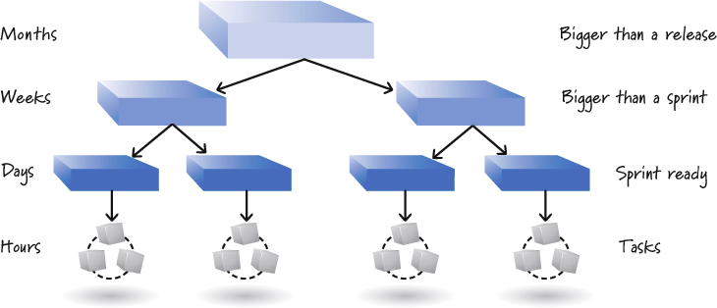
Level of Detail
User stories exist at varying levels of detail
Small stories are used at the sprint level
Larger (less-detailed) stories are used at the lower priority levels of the product backlog

Slide 68
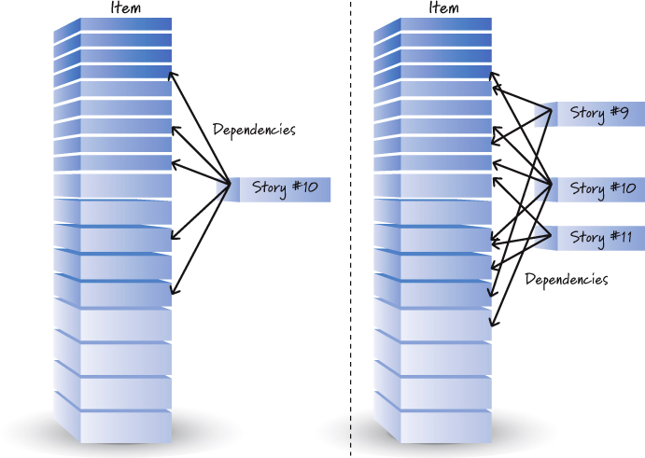
INVEST in Good Stories
Independent:
INVEST
6 criteria to make sure our stories are good
Independent
Negotiable
Valuable
Estimable
Small (sized appropriately)
Testable
Notes:
Independent: As much as is practical, user stories should be independent or at least only loosely coupled with one another.
Negotiable: The details of stories should also be negotiable.
Valuable: Stories need to be valuable to a customer, user, or both. Customers (or choosers) select and pay for the product.
Estimable: Stories should be estimatable by the team that will design, build, and test them.
Small (sized appropriately): Stories should be sized appropriately for when we plan to work on them. Stories worked on in sprints should be small. If we’re doing a several-week sprint, we want to work on several stories that are each a few days in size.
Testable: Stories should be testable in a binary way—they either pass or fail their associated tests. Being testable means having good acceptance criteria

Slide 69
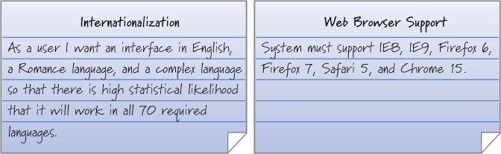
Nonfunctional Requirements
Nonfunctional requirements can be represented as stories.

Slide 70
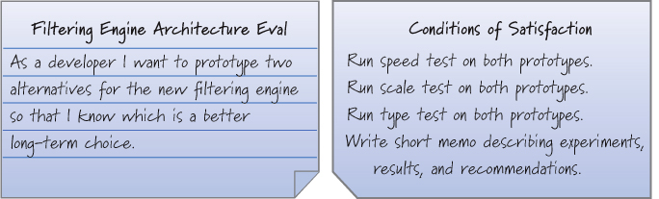
Knowledge Acquisition Stories
Sometimes need to create backlog item that focuses on knowledge acquisition.
Other names for these stories:
prototype, proof of concept, experiment, study, spike

Slide 71
Gathering Stories
How do user stories come into existence?
Traditional approaches to requirements gathering involve asking the users what they want.
So, if you ask a user, “What do you want?” she may or may not be able to answer. Even if she does answer the question and we build exactly what she asked for, she may say, “Yep, you gave me exactly what I asked for, and now that I see it, I want something different.”
A better approach is to involve the users as part of the team that is determining what to build and is constantly reviewing what is being built.
Use a user-story-writing workshop
Product owner, ScrumMaster, and dev team get together with stakeholders from a few hours to a few days to brainstorm stories.

Slide 72
Product Backlog
Topics:
Overview
Product Backlog Items (PBI’s)
Good Product Backlog Characteristics
Grooming
Definition of Ready
Flow Management

Slide 73
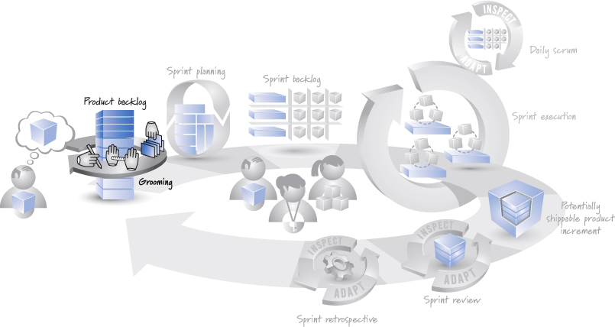
Overview
The product backlog is a prioritized list of desired product functionality.
It is a highly visible artifact at the heart of the Scrum framework that is accessible to all project participants

Slide 74
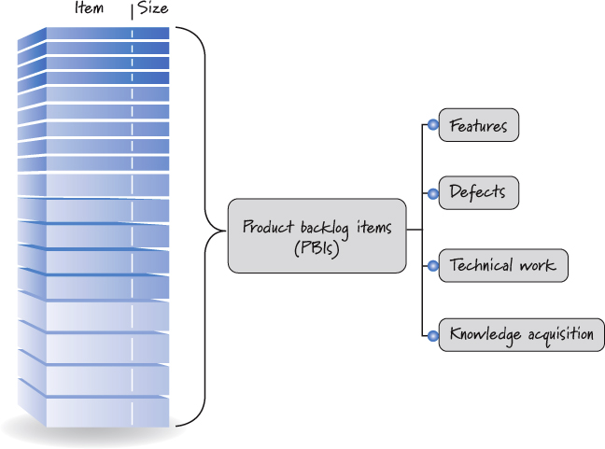
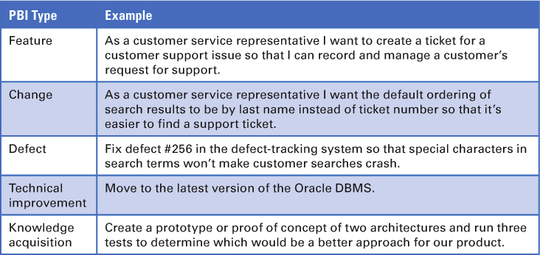
Product Backlog Items (PBI’s)
The product backlog is composed of backlog items

Slide 75
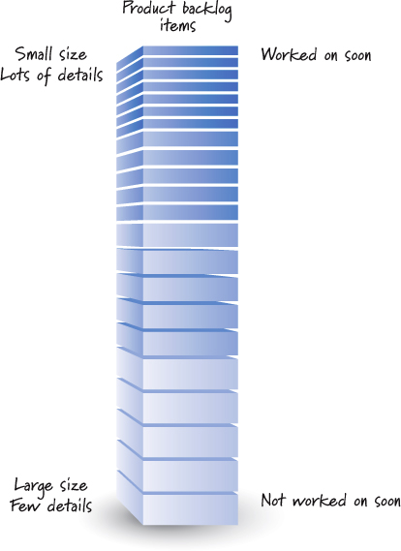


Good Product Backlog Characteristics
Good product backlogs satisfy the DEEP requirements
Detailed appropriately
Emergent
Estimated
Prioritized
Detailed appropriately:
Estimated:
Prioritized:
Notes:
Detailed appropriately: Not all items in a product backlog will be at the same level of detail at the same time
Emergent: As long as there is a product being developed or maintained, the product backlog is never complete or frozen.
Estimated: Each product backlog item has a size estimate corresponding to the effort required to develop the item
Prioritzed: Although the product backlog is a prioritized list of PBIs, it is unlikely that all of the items in the backlog will be prioritized

Slide 76


Grooming
Grooming refers to a set of three principal activities:
Creating and refining (adding details to) PBIs
Estimating PBIs
Prioritizing PBIs.
Notes:
Who Does the Grooming?
Grooming the product backlog is an ongoing collaborative effort led by the product owner and including significant participation from internal and external stakeholders as well as the ScrumMaster and development team
When Does Grooming Take Place?
The Scrum framework only indicates that grooming needs to happen; it doesn’t specify when it should happen. So when does grooming actually take place?
We expect the product backlog to evolve constantly rather than being locked down early and changed only through a secondary process for handling exceptional, undesirable occurrences.

Slide 77


Definition of Ready
Ready
Grooming the product backlog should ensure that items at the top of the backlog are ready to be moved into a sprint so that the development team can confidently commit and complete them by the end of a sprint.
Scrum teams formalize this idea by establishing a definition of ready.
You can think of the definition of ready and the definition of done as two states of product backlog items during a sprint cycle
Example:

Slide 78


Flow Management
Release flow management
The product backlog must be groomed in a way that supports ongoing release planning
Sprint flow management
Product backlog grooming is essential for effective sprint planning and the resulting flow of features into a sprint.

Slide 79
Estimation & Velocity
Topics:
Overview
What and when We Estimate
PBI Estimation Concepts
PBI Estimation Units
Planning Poker
What is Velocity?
Calculate a Velocity Range
Forecasting Velocity
Affecting Velocity
Misusing Velocity

Slide 80

Overview
When planning we need to answer important questions:
“How many features will be completed?”
“When will we be done?”
“How much will this cost?”
To answer these questions we need to estimate the size of what we are building and measure the velocity or rate at which we can get work done.
With that information, we can derive the likely product development duration (and the corresponding cost) by dividing the estimated size of a set of features by the team’s velocity

Slide 81

What and when We Estimate
Throughout the development life of a product we need to estimate at varying levels of granularity and, thus, will use different units to do so.

Slide 82





PBI Estimation Concepts
Several important concepts scrum teams use when estimating PBI’s
Estimate as a team
Estimates are not commitments
Accuracy vs. precision
Relative size estimation
Notes:
Estimate as a Team: The people who will do the work collectively provide the estimates.

Slide 83
PBI Estimation Units
Story points
Measure the bigness or magnitude of a PBI
Combine factors like complexity and physical size into one relative size measure
The goal is to be able to compare stories and say things like “Well, if the create-a-ticket story is a 2, then the search-for-a-ticket story is an 8,”

Slide 84





Planning Poker
Technique for sizing PBI’s
Estimation scale
Modified Fibonacci sequence
1, 2, 3, 5, 8, 13, 20, 40, 100
Group (bin) like sized PBI’s
Common interpretation of cards
Notes:
The rules of Planning Poker are as follows:
1. The product owner selects a PBI to be estimated and reads the item to the team.
2. Development team members discuss the item and ask clarifying questions to the product owner, who answers the questions.
3. Each estimator privately selects a card representing his estimate.
4. Once each estimator has made a private selection, all private estimates are simultaneously exposed to all estimators.
5. If everyone selects the same card, we have consensus, and that consensus number becomes the PBI estimate.
6. If the estimates are not the same, the team members engage in a focused discussion to expose assumptions and misunderstandings. Typically we start by asking the high and low estimators to explain or justify their estimates.
7. After the discussion, we return to step 3 and repeat until consensus is reached.
Benefits
Planning Poker brings together the diverse team of people who will do the work and allows them to reach consensus on an accurate estimate that is frequently much better than any one individual could produce.

Slide 85
What is Velocity?
Velocity is the amount of work completed each sprint.
Measured by adding the sizes of the PBIs that are completed by the end of the sprint.
Velocity is used for two important purposes.
First, it is an essential concept for Scrum planning.
Second, by observing its own velocity over time, the team can gain insight into how specific process changes affect the delivery of measurable customer value.

Slide 86

Calculate a Velocity Range
For planning purposes, velocity is most useful when expressed as a range
E.g. “The team is typically able to complete between 25 and 30 points each sprint.”

Slide 87
Forecasting Velocity
How do we handle the situation where we have a new team whose members haven’t worked together and therefore have no historical data?
One way is to have team do first sprint planning and use that value as their velocity.
Over time velocity will become more accurate as more sprints are completed.
Another way is to use velocity value from another team that does similar work.
This initial velocity can be thrown out once the new team has completed their first sprint.

Slide 88

Affecting Velocity
An executive once said, “Last year my team’s velocity averaged 30 points per sprint. This year I’m expecting the team to achieve 35 points per sprint.”
This executive believes that the team’s velocity should correspond to trend 1
Notes:
I would expect a team that is aggressively trying to improve itself and is focused on delivering features in accordance with a robust definition of done and low technical debt (see Chapter 8) to see an increase in velocity. Well, at least an increase up to a certain point, at which time its velocity will likely plateau (more like trend 2 in Figure 7.13).

Slide 89
Misusing Velocity
Velocity should not be used as a performance metric in an attempt to judge team productivity.
When misused in this way, velocity can motivate wasteful and dangerous behavior.
For example, say I have decided to give the largest bonus to the team that has the highest velocity.
Teams may not be sizing their PBI’s using a common baseline.
Once teams realize velocity is being used as a performance metric they will inflate points.

Slide 90
Conclusion
Topics:
Get Going!

Slide 91
Get Going!
Don’t worry about getting things perfect up front
You can’t!
Trying to be perfect up front will force you to guess at the expense of important learning that you will only get by applying scrum and seeing what happens.
Your first few sprints won’t be all that pretty
That’s OK
Your goal should simply be to get better with each sprint
Hopefully this presentation has helped you see the benefits of scrum
Best of luck applying scrum to your complex project!

